Slide 1
INTERACTIVE SCIENCE NOTEBOOKS (ISN)
Notes:
‹#›

Slide 2
What is an Interactive Science Notebook?
An interactive science notebook (ISN) is your own personalized SCIENCE BOOK.
A portfolio of your work in ONE spot that you bring EVERY DAY. This is a great resource for STUDYING for quizzes & tests.
A great ORGANIZATIONAL tool that gives you permission to be COLORFUL and CREATIVE to show me what you know or have learned.
Allows you to be like a REAL SCIENTIST by asking QUESTIONS, RECORDING what you observe, and SHARING it with your classmates!

Slide 3
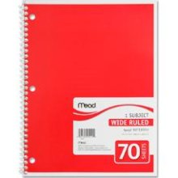
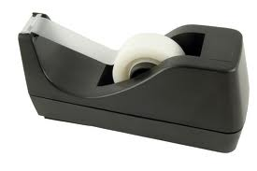
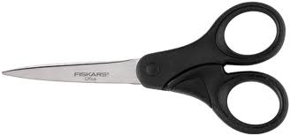
Science Notebook Supplies
Colored Pencils
Pencils
Spiral Notebook
Scissors
Tape
NO MARKERS

Slide 4
The ISN is divided into TWO sections:
“LOVES” YOUR work. This is the side that you can use to show me what you learned in a creative and colorful way.
This is the “output” or product side.
Even-numbered pages
“RESTRICTED” to Ms. Harbour’s input work
Contains info my teacher tells me to “ADD” or “WRITE”
This is the “input” side or info side.
Odd-numbered pages

Slide 5
WHAT GOES WHERE?
Left Side
Student Output
Lots of Color, Diagrams, & Doodles
Concept Maps/Organizers
Drawings
Reflective Writing
Questions
Data Charts and Graphs
Songs, Poems, or Riddles
Data from Experiments
Cartoons or cartoon strips
Right Side
Teacher Input/Content
Pencil
Information given in class
Lecture Notes
Lab Activities
Video Notes
Summaries
Textbook Notes
Procedures for experiments
Classroom Specific Information

Slide 6
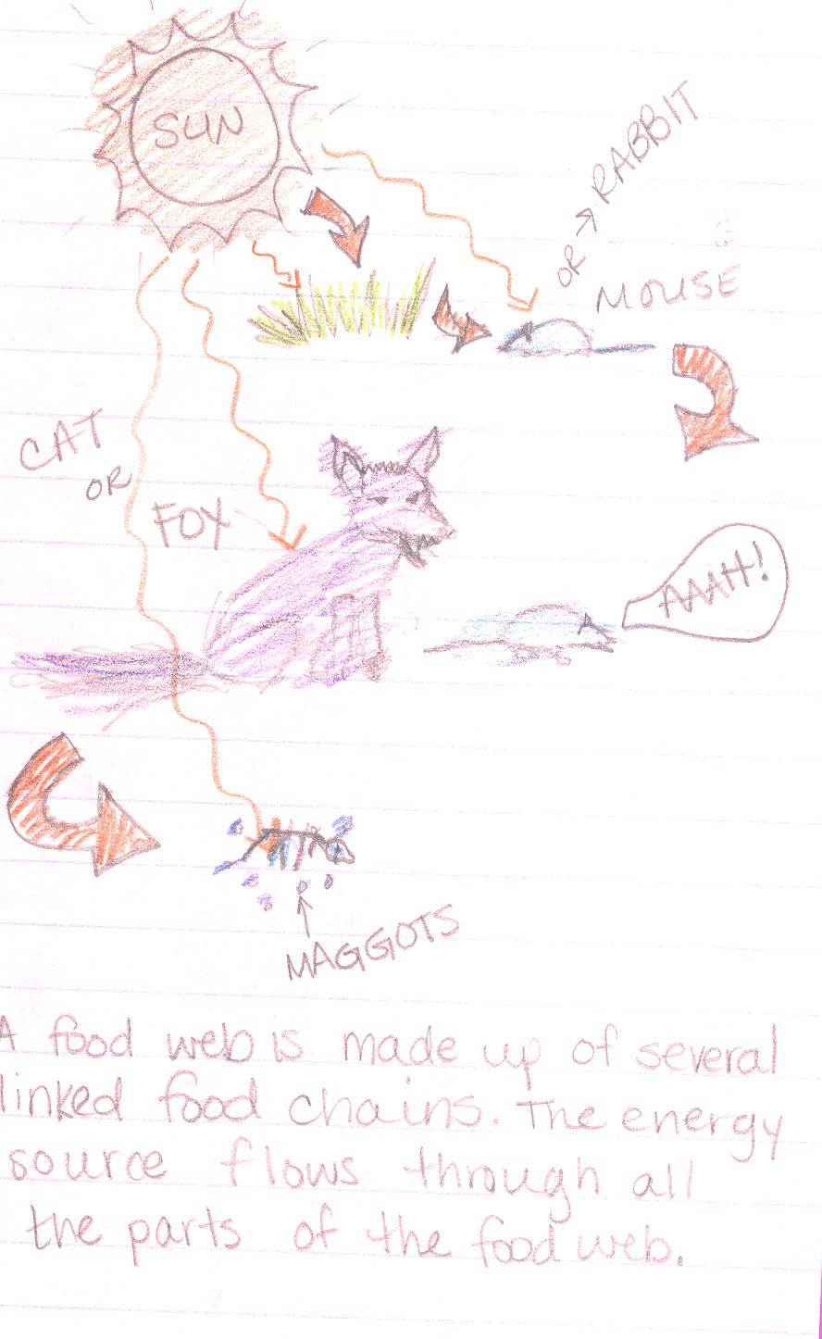
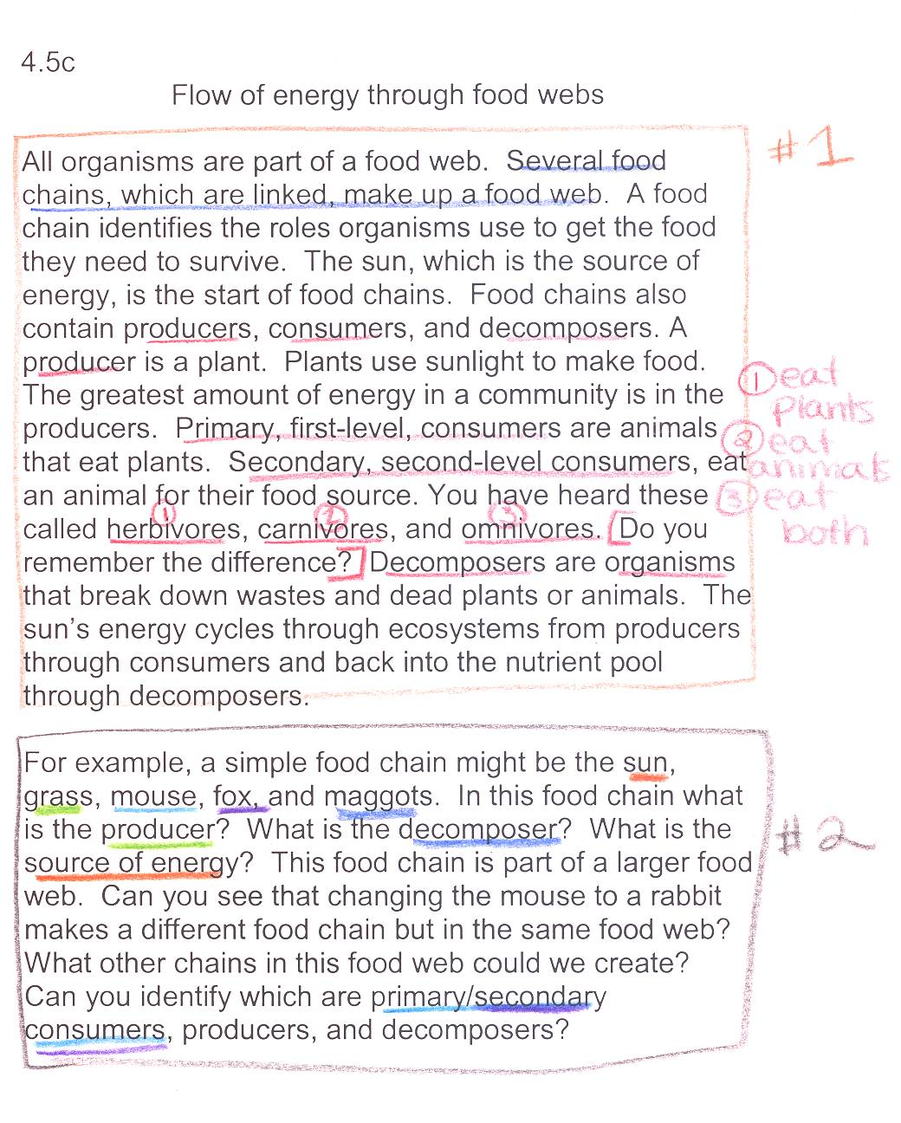
Example page:
OUTPUT (your interpretation)
INPUT (notes from teacher)

Slide 7
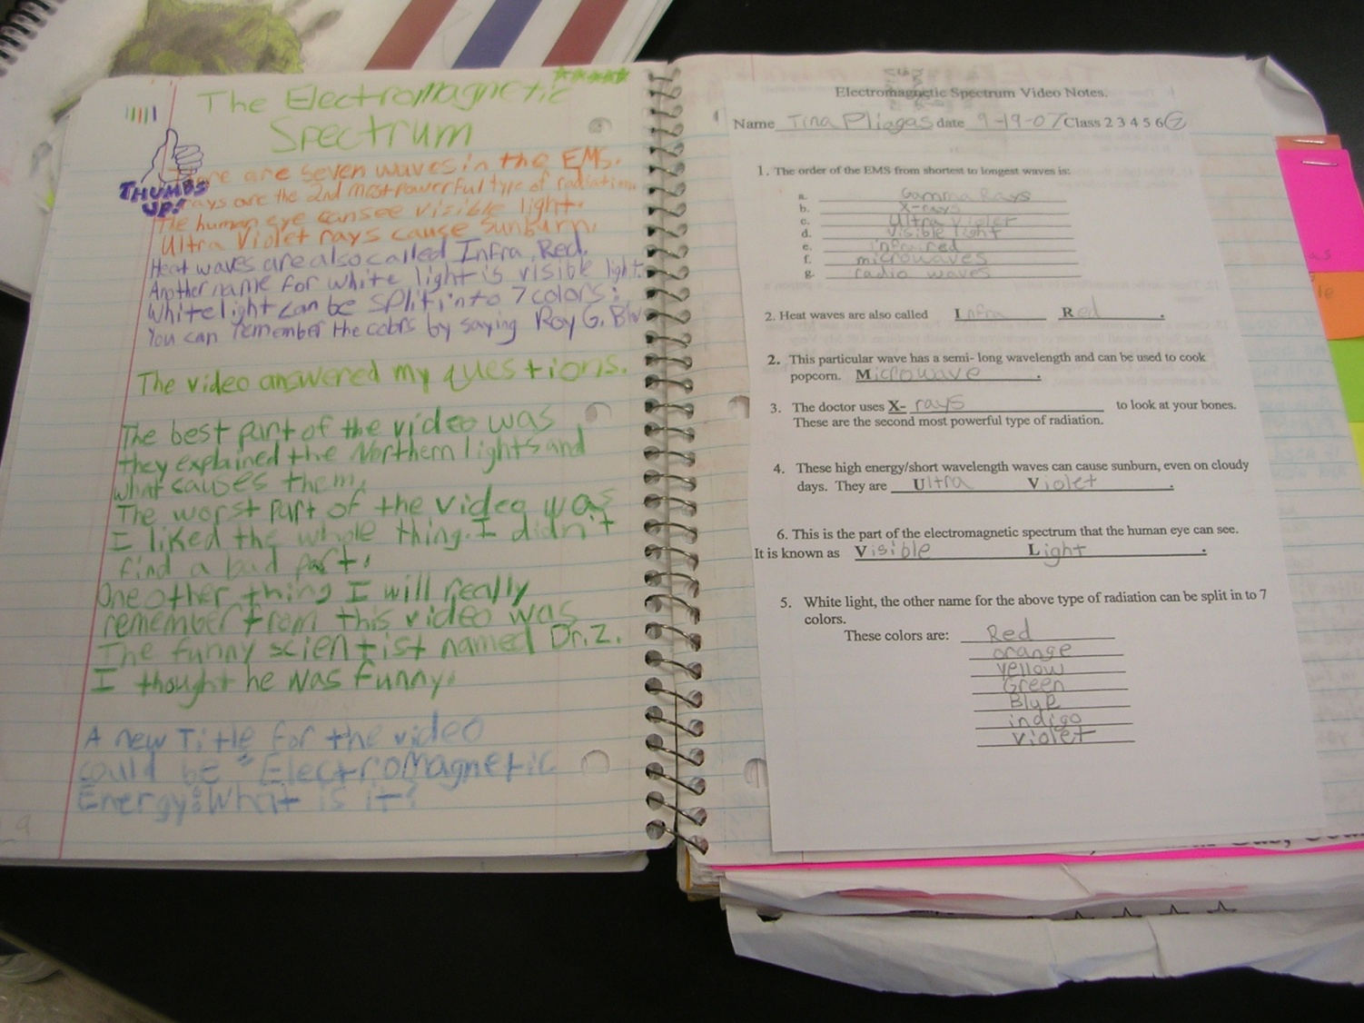
OUTPUT (your interpretation)
INPUT (notes from teacher)

Slide 8
Notebook Guidelines
Do not RIP OUT pages or tear corners.
All handouts MUST BE TAPED IN!
Please don’t DOODLE unless it relates to science.
Your ISN should only be used for SCIENCE CLASS and COMES TO CLASS EVERYDAY!
Each page should have the DATE and PAGE#.
BE COLORFUL, CREATIVE, & LOVE YOUR NOTEBOOK!

Slide 9
QUESTIONS?

